Slide 1

BIRD species identification
Nitasha

Slide 2

content
3 | Introduction
4 | Input data
5 | model
6 | Results
10 | Web site
13 | summary

Slide 3
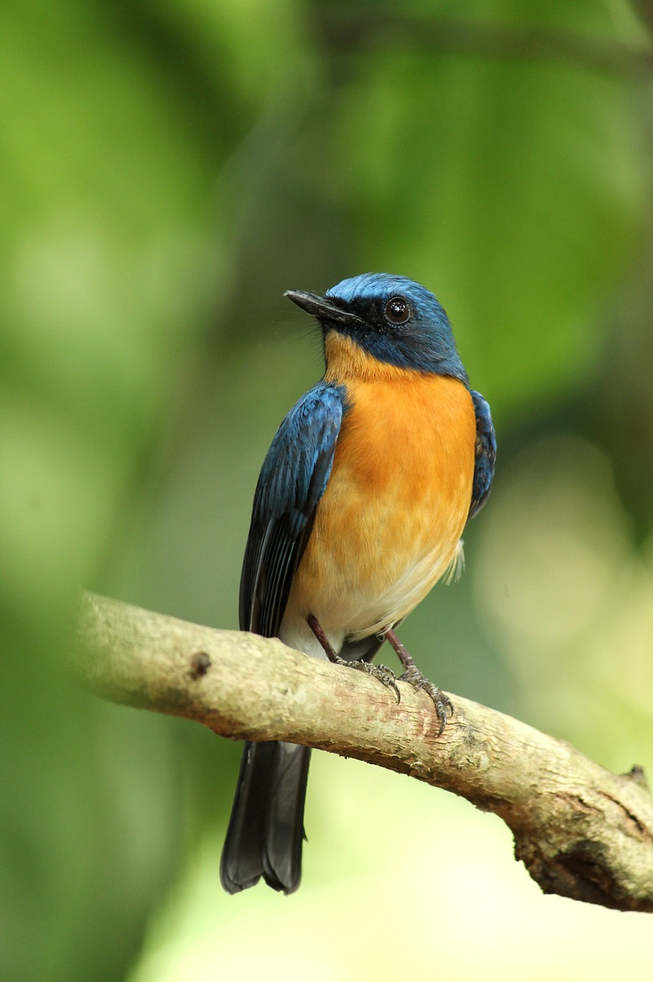
INTRODUCTION
This project dives machine learning methodologies in the realm of bird image classification, with a particular emphasis on their implications for educational initiatives. The primary objective is to develop robust classification models capable of accurately identifying avian species from visual data. Primary focus is on 10 species of birds.

Slide 4
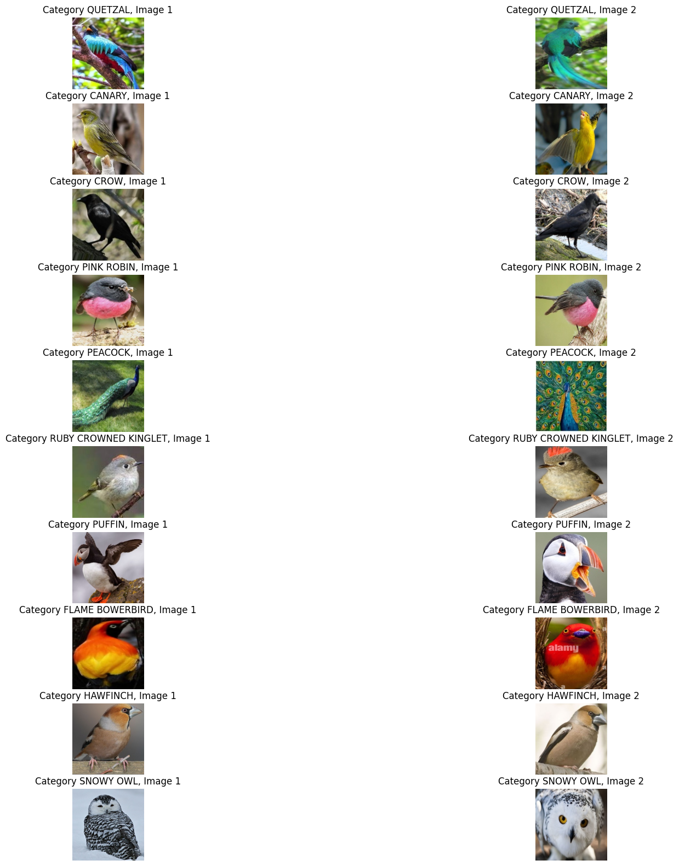
Input data

Slide 5
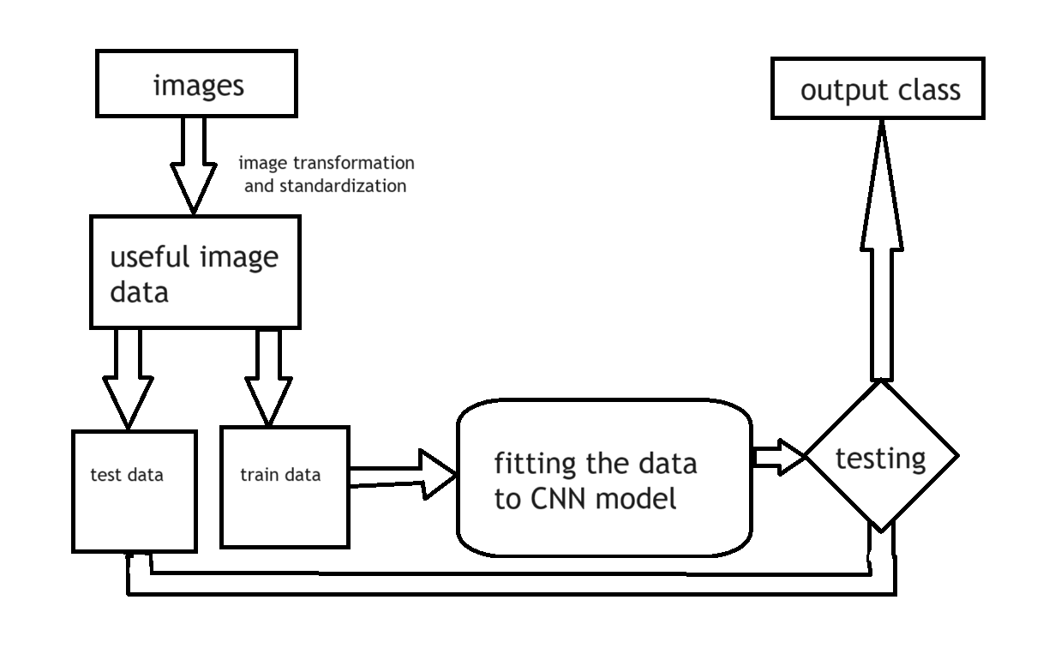
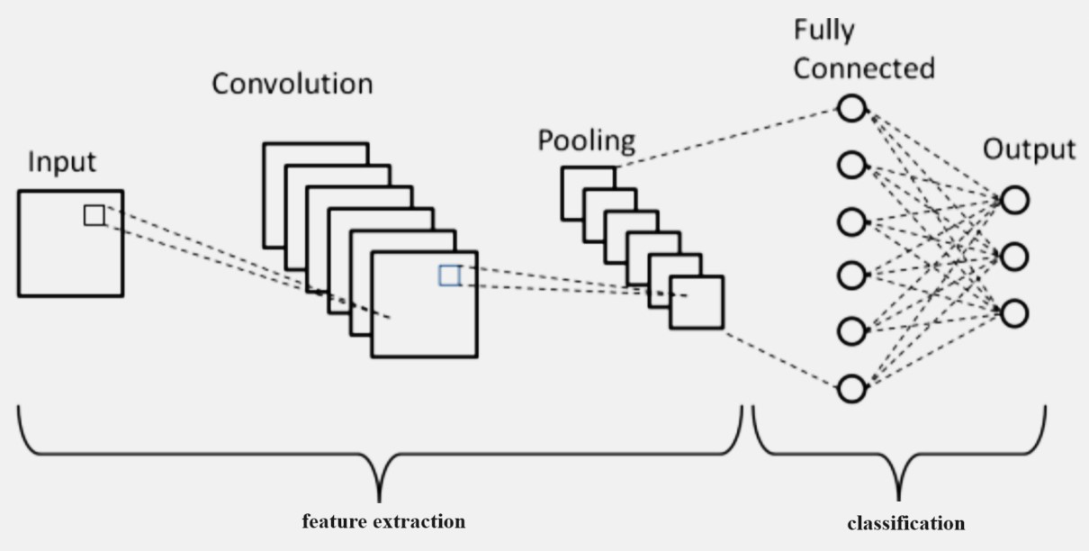
Model
CNN
Convolutional Neural Networks (CNNs) are a class of deep learning models specifically designed for processing grid-like data, such as images. They consist of multiple layers, including convolutional, pooling, and fully connected layers, each performing specific operations to extract and learn hierarchical features from input images.

Slide 6
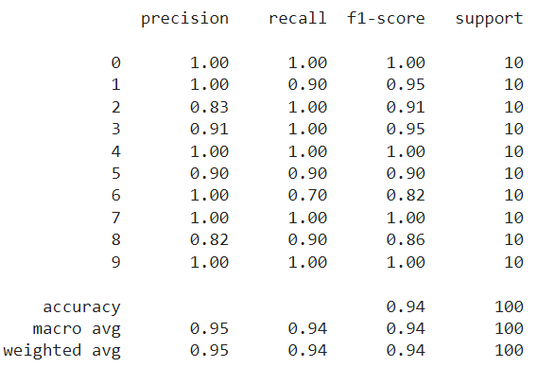
Results
The model accurately classified 94 out of 100 images.

Slide 7
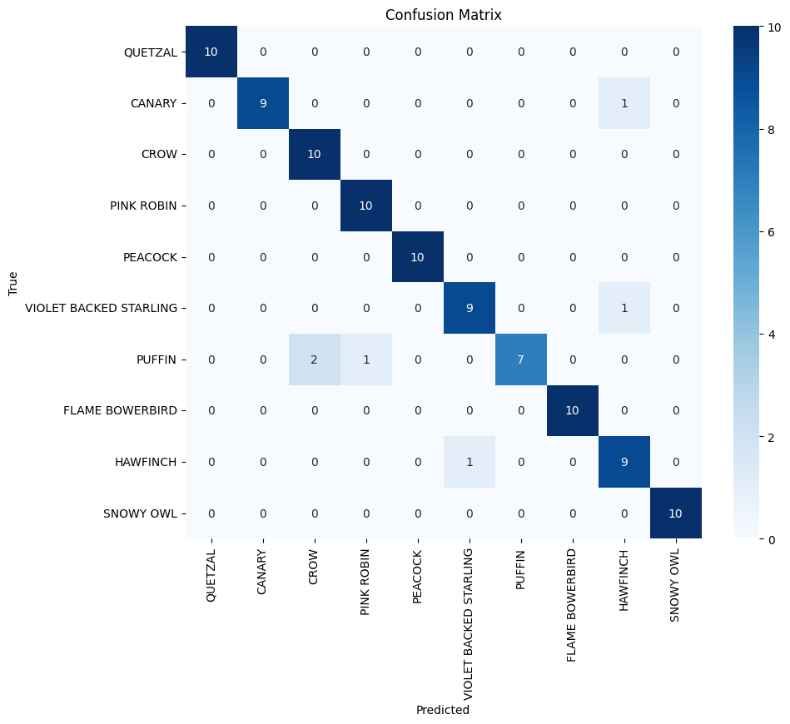
CONFUSION MATRIX

Slide 8
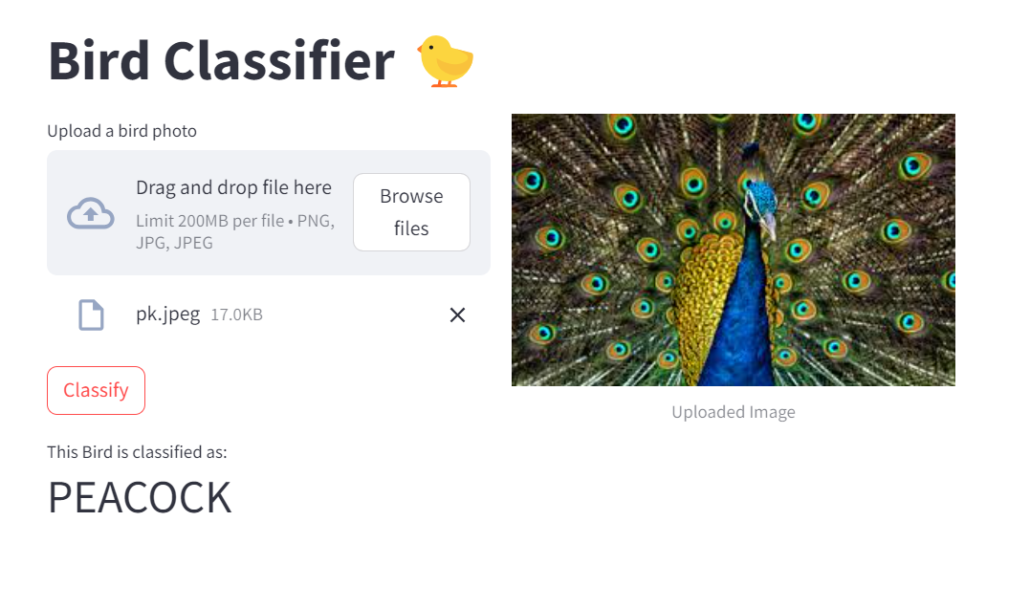
website
features
You can upload any bird image from your computer using browse files.
The website has a modern and easy to use approach.
The bird will be classified into either of the 10 categories by pre trained model dynamically.
The future scope of the project includes more images to classify and better UI experiences.
The website was made using STREAMLIT.

Slide 9
SUMMARY
A website was created using Streamlit to classify 10 species of birds accurately with a convolutional neural network (CNN) model. The development process involved training a CNN on a labeled dataset of bird images, with a focus on data pre-processing techniques such as normalization, augmentation, and standardization to enhance model performance. The trained model was integrated into a Streamlit app, providing an interactive user interface where users can upload bird images for classification. The app displays the predicted species along with the confidence level of the prediction, leveraging the powerful and user-friendly features of Streamlit to deliver a seamless and efficient bird species identification tool.

Slide 10
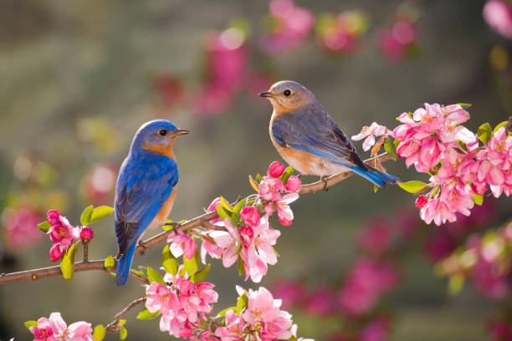
THANK YOU
Nitasha
AI-ML end term project
https://birdclassifier2210991996.streamlit.app/

